Slide 1
Statistics in Sports: Course Introduction + Overview and History of Sports Analytics
Zachary Binney, PhD MPH
Oxford college of emory university
Fall 2023

Slide 2
Roadmap
1. Course Introduction + Overview
Course Goals
Syllabus Review
2. Overview of Sports Analytics Applications
3. Sports Analytics History
“Culture Wars”

Slide 3
Course Introduction + Overview

Slide 4
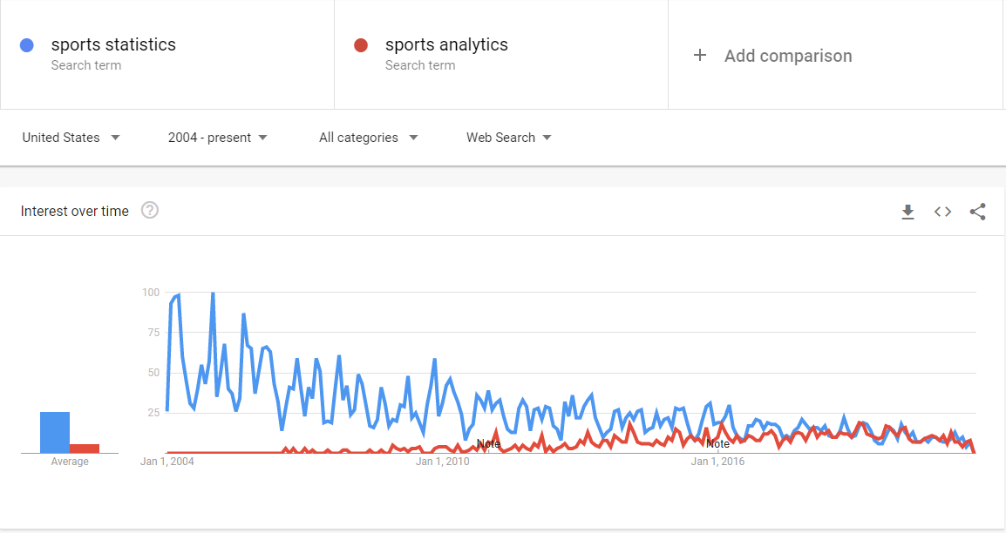
What is this class about?
Sports Analytics: my definition
Science of learning by asking and answering questions with data in sports
Source: Google Trends

Slide 5
What are we doing?
1. Improve our overall problem solving and critical thinking
2. Learn how we learn from data by asking meaningful questions and rigorously examining relevant data/evidence in sports
3. Gain an understanding of basic statistical/analytical concepts and their applications in sports (using R)
Data Acquisition, Storage, and Access
Data Analysis
Data Visualization
4. Practice effectively communicating analytical findings, arguments, and conclusions to diverse audiences

Slide 6
Syllabus Review
Open your syllabi!

Slide 7
Overview of Sports Analytics Applications

Slide 8
Why Sports Analytics?
What are some applications you can see? Chat with your neighbors.
STOP!
DON’T LOOK AT FUTURE SLIDES YET.

Slide 9
Why Sports Analytics?
Sports Analytics: why do we need nerds?
Mental limitations/cognitive biases
Data isn’t perfect in this realm, either
Situational limitations (time)
Everyone, including coaches and scouts, uses data/stats – some don’t phrase it as “analytics”

Slide 10
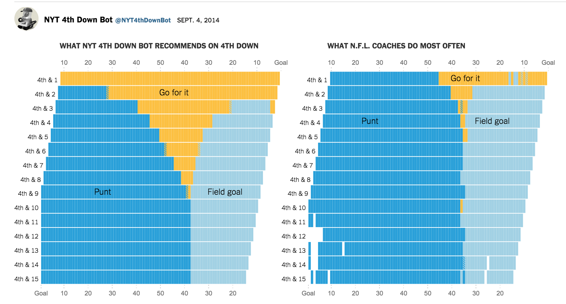
Sports Analytics Applications
In-game strategy and decision-making
Source:

Slide 11
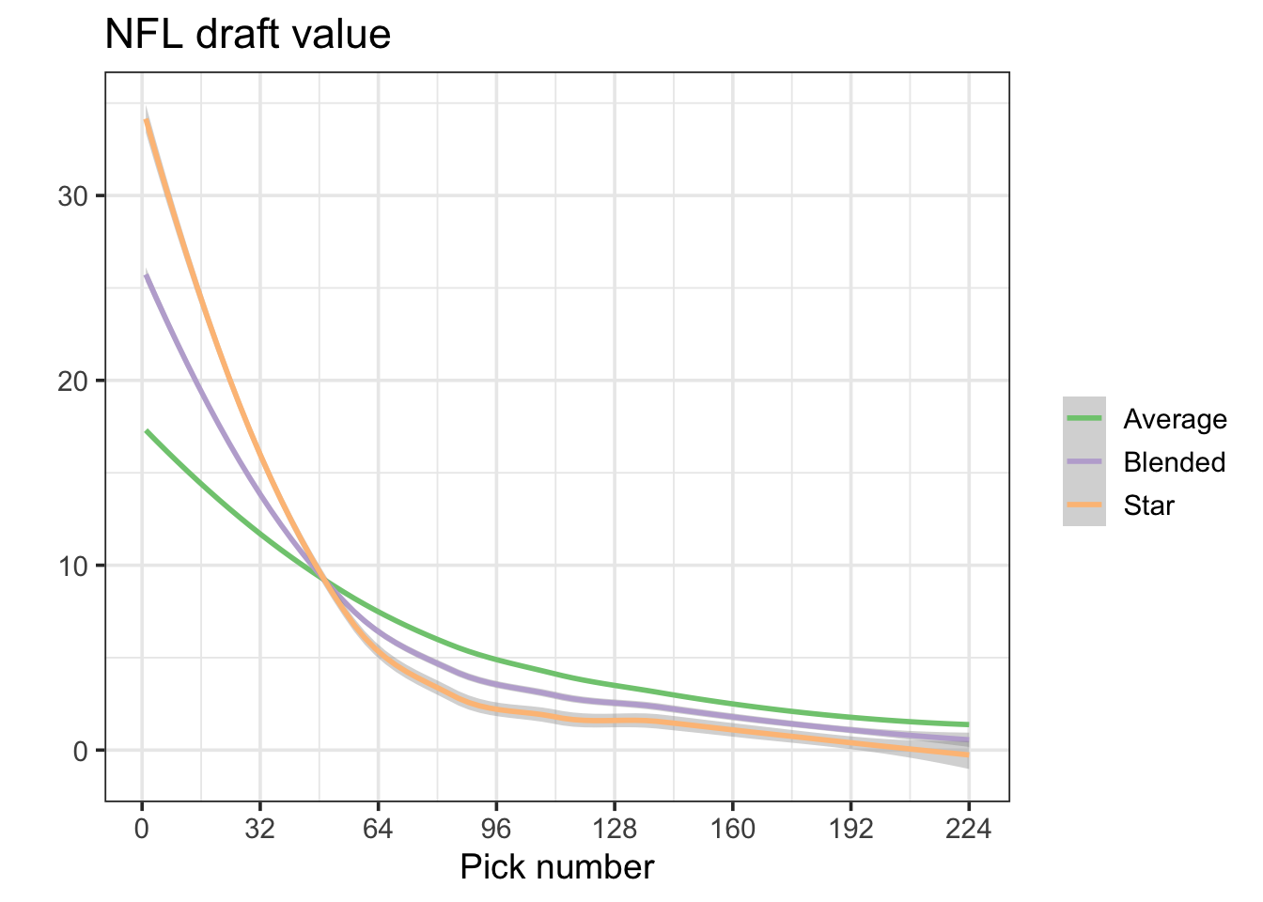
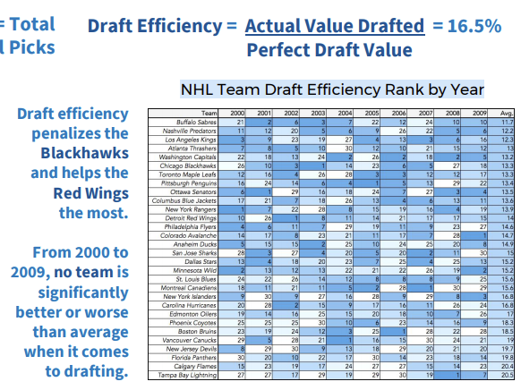
Sports Analytics Applications
Player evaluation (amateur scouting/draft strategy)
Source: https://statsbylopez.netlify.app/post/rethinking-draft-curve/, https://nessis.org/nessis17/Nandakumar.pdf

Slide 12
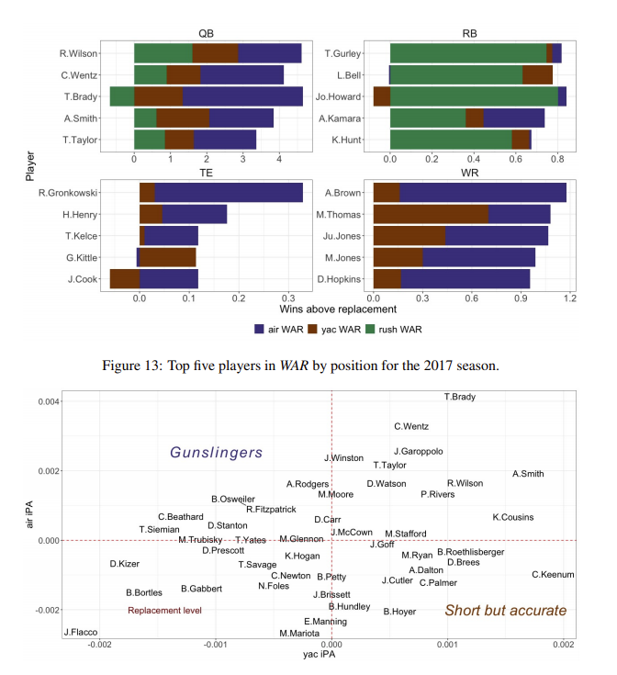
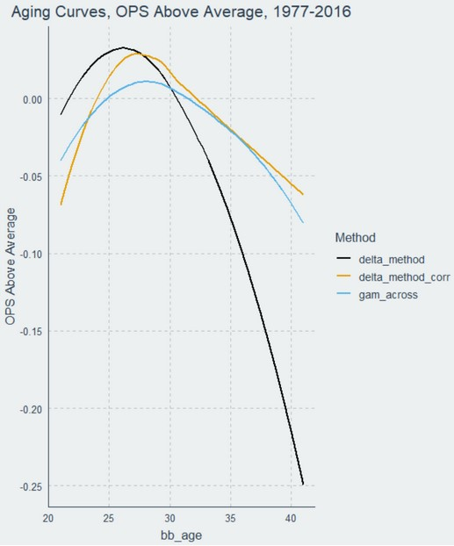
Sports Analytics Applications
Player evaluation (pro scouting)
Source: https://www.baseballprospectus.com/news/article/59972/the-delta-method-revisited/, https://arxiv.org/abs/1802.00998

Slide 13
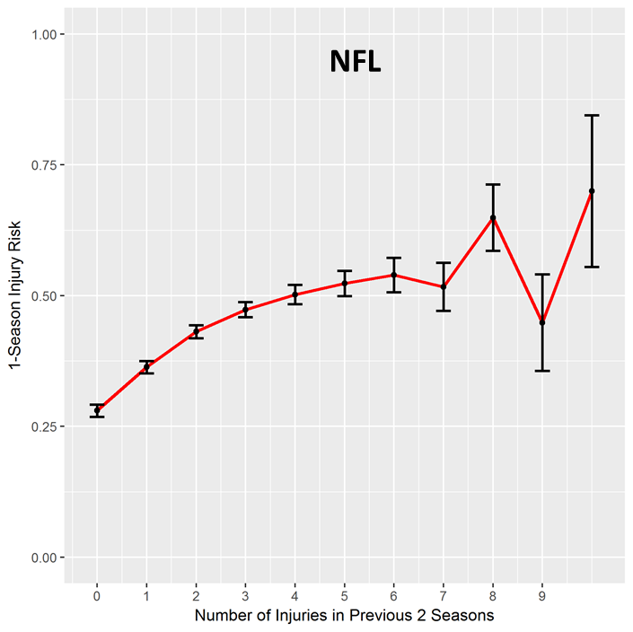
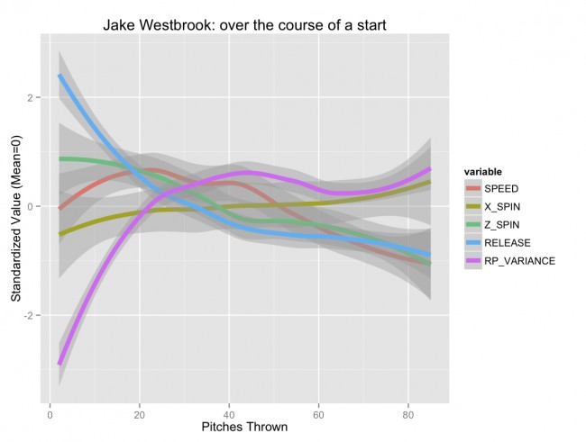
Sports Analytics Applications
Sports science, injuries, athlete health
Source: My dissertation on NFL injuries; https://tht.fangraphs.com/the-injury-zone-revisited/

Slide 14
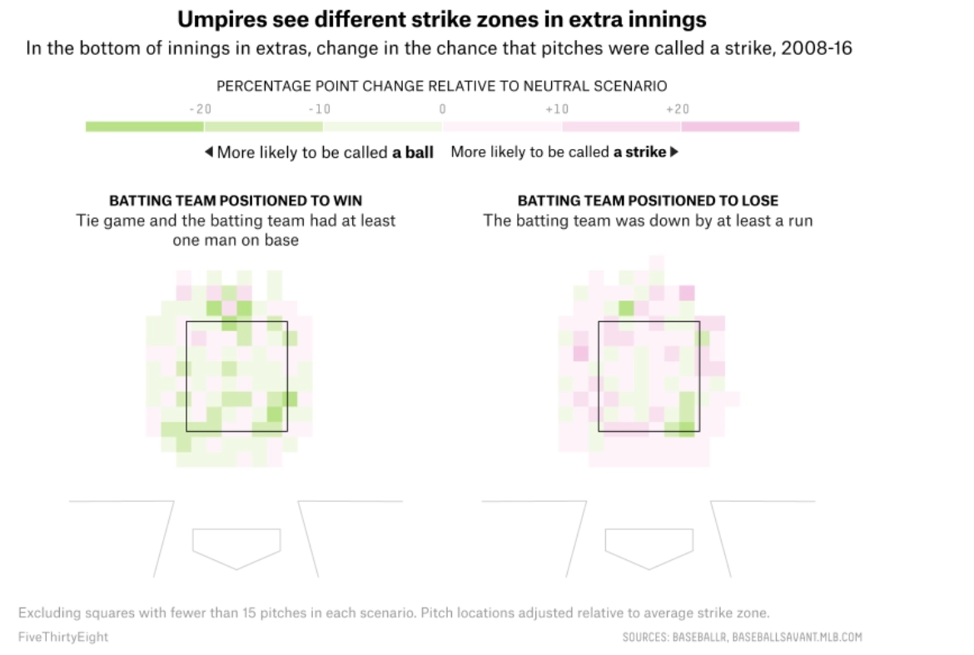
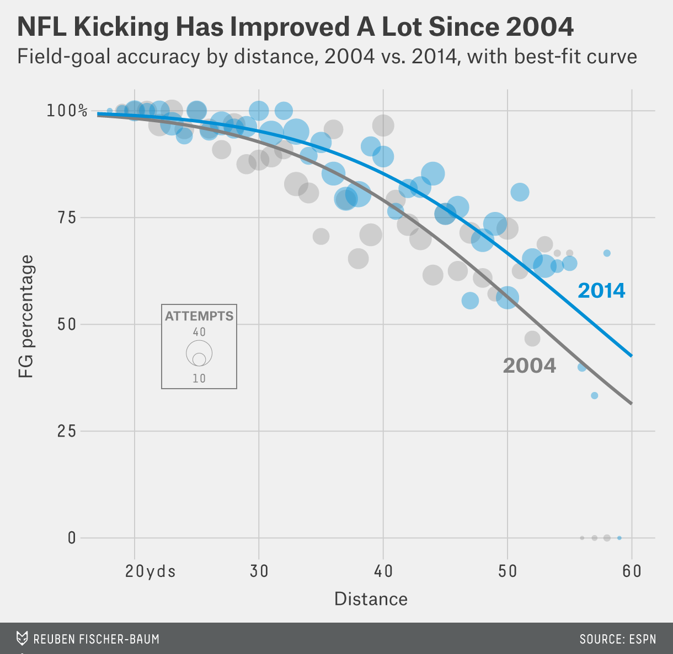
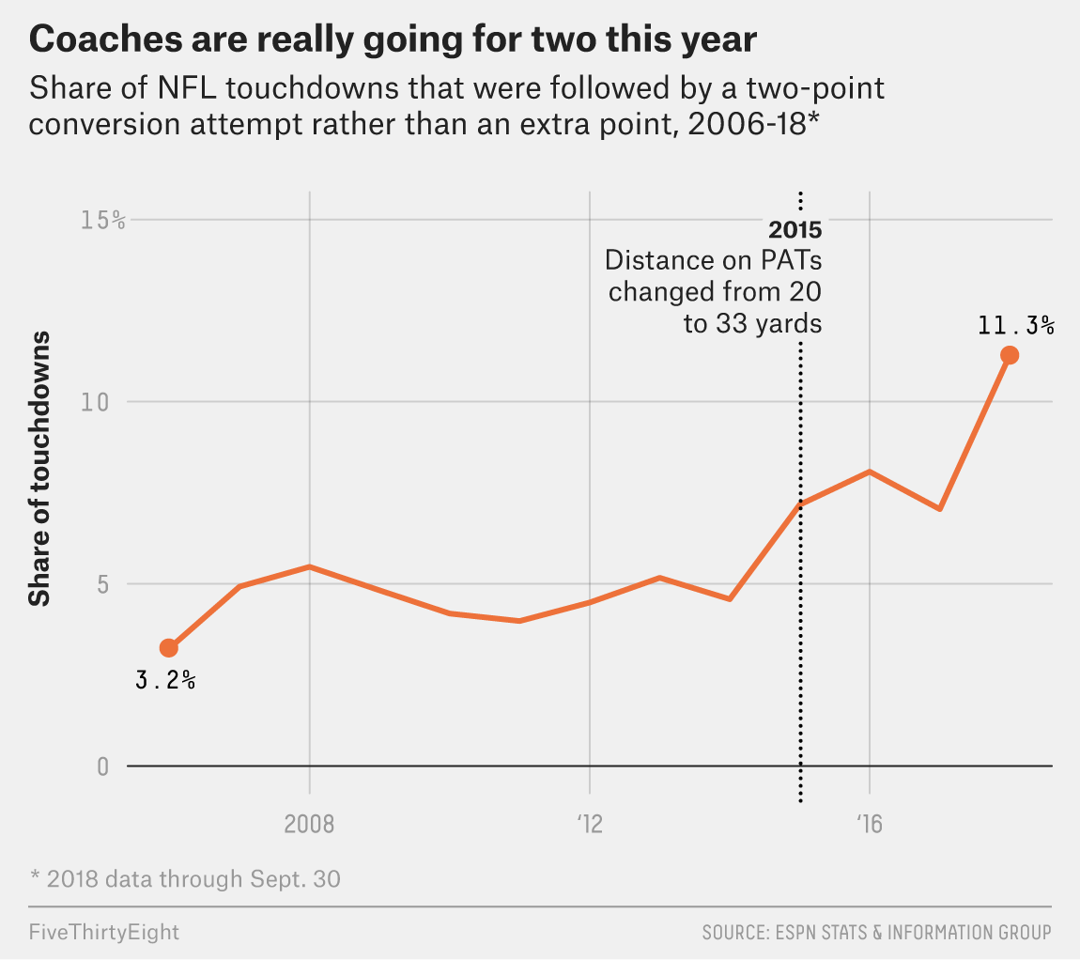
Sports Analytics Applications
League development (e.g. rule changes)
Source: https://fivethirtyeight.com/features/everyone-wants-to-go-home-during-extra-innings-maybe-even-the-umps/; https://operations.nfl.com/gameday/analytics/stats-articles/what-data-and-analytics-told-us-about-2021-offseason-nfl-rules-proposals/; https://fivethirtyeight.com/features/nfl-coaches-are-going-for-two-more-than-ever-it-took-them-long-enough/; https://fivethirtyeight.com/features/we-thought-nfl-kickers-would-keep-getting-better-but-this-year-theyre-struggling/; https://fivethirtyeight.com/features/kickers-are-forever/

Slide 15
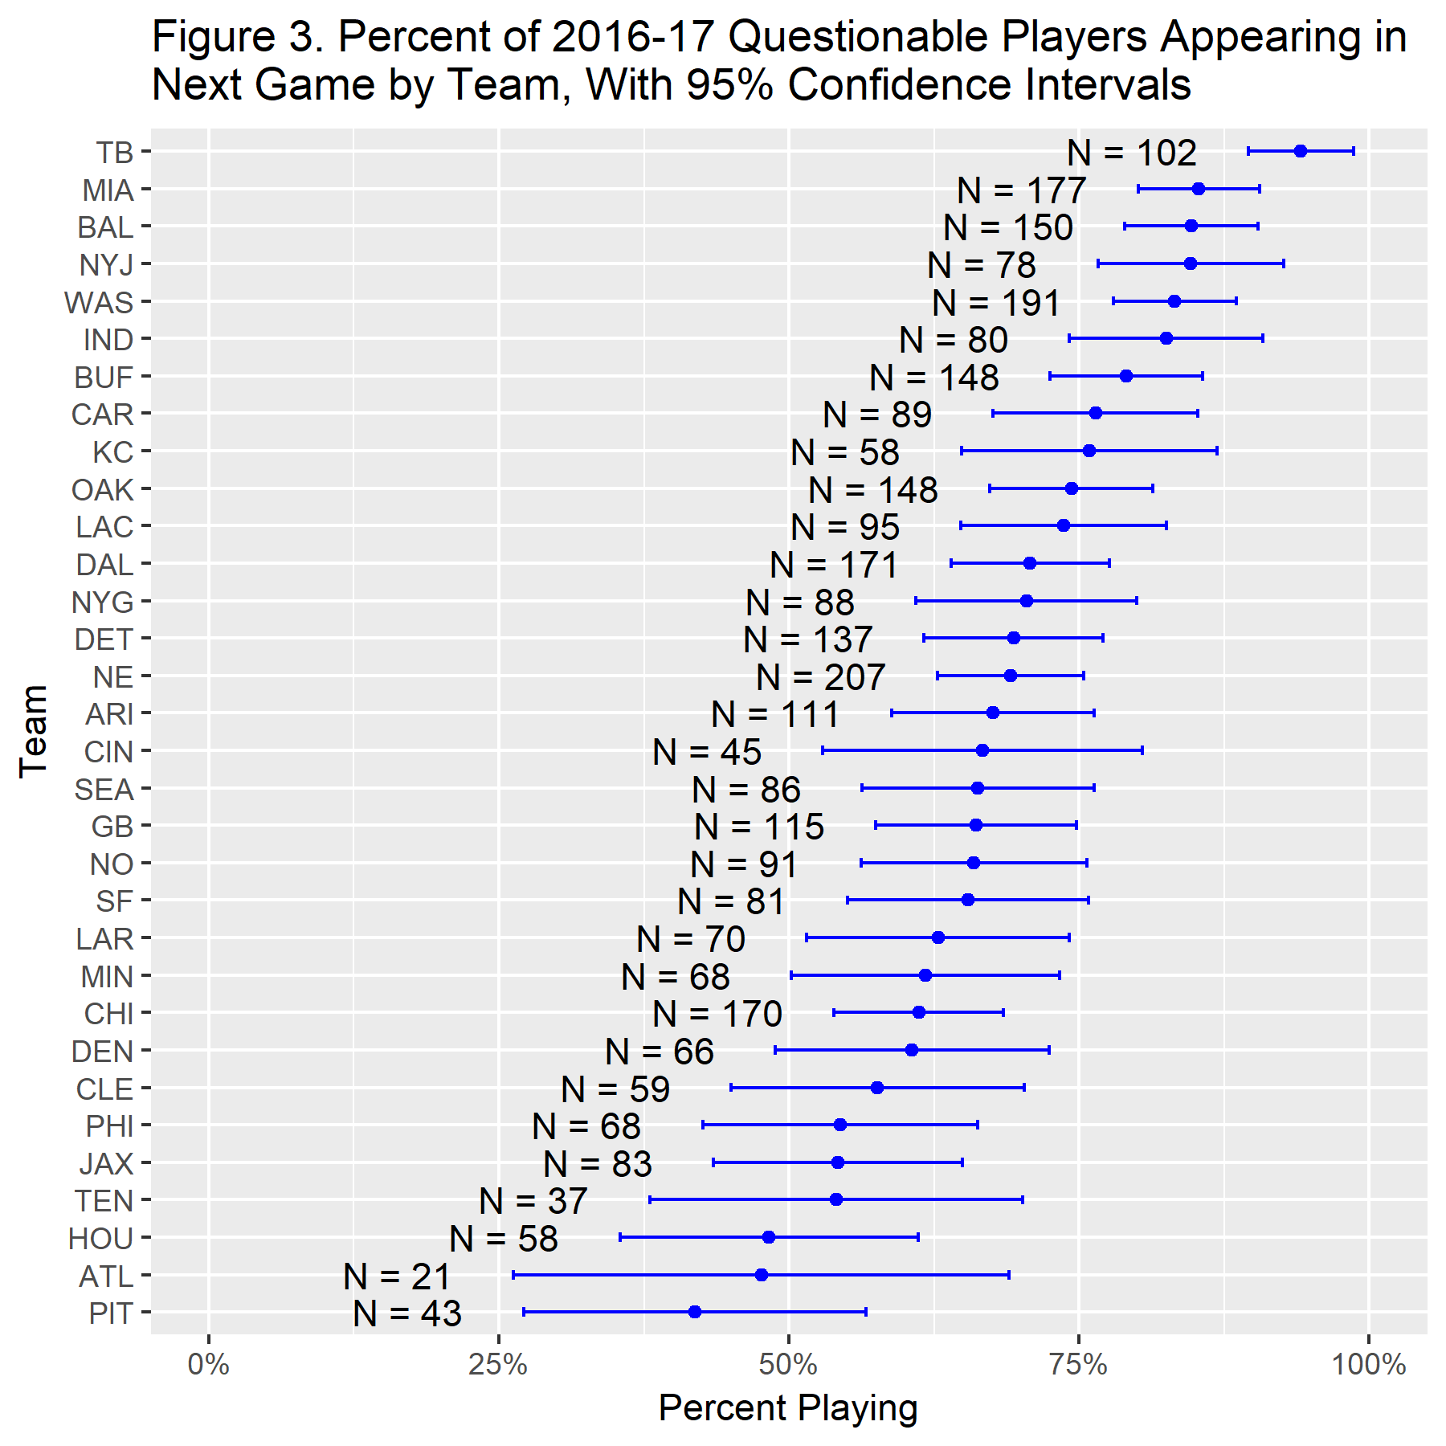
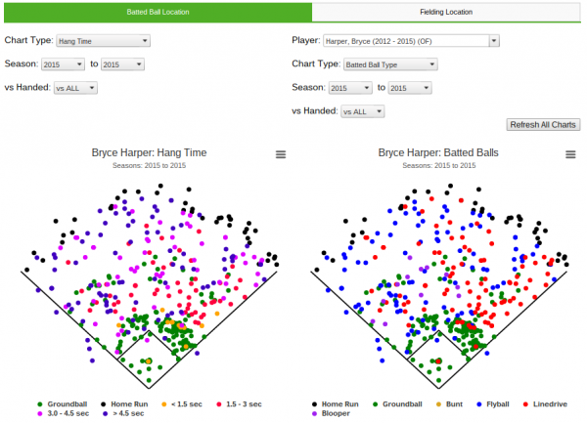
Sports Analytics Applications
Opponent Scouting
Source: https://library.fangraphs.com/features/spray-charts/, https://www.footballoutsiders.com/stat-analysis/2018/questionable-behavior

Slide 16
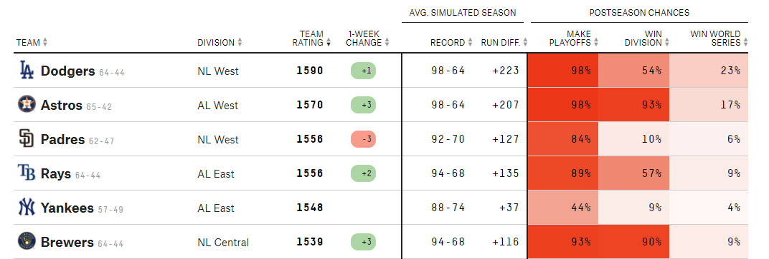
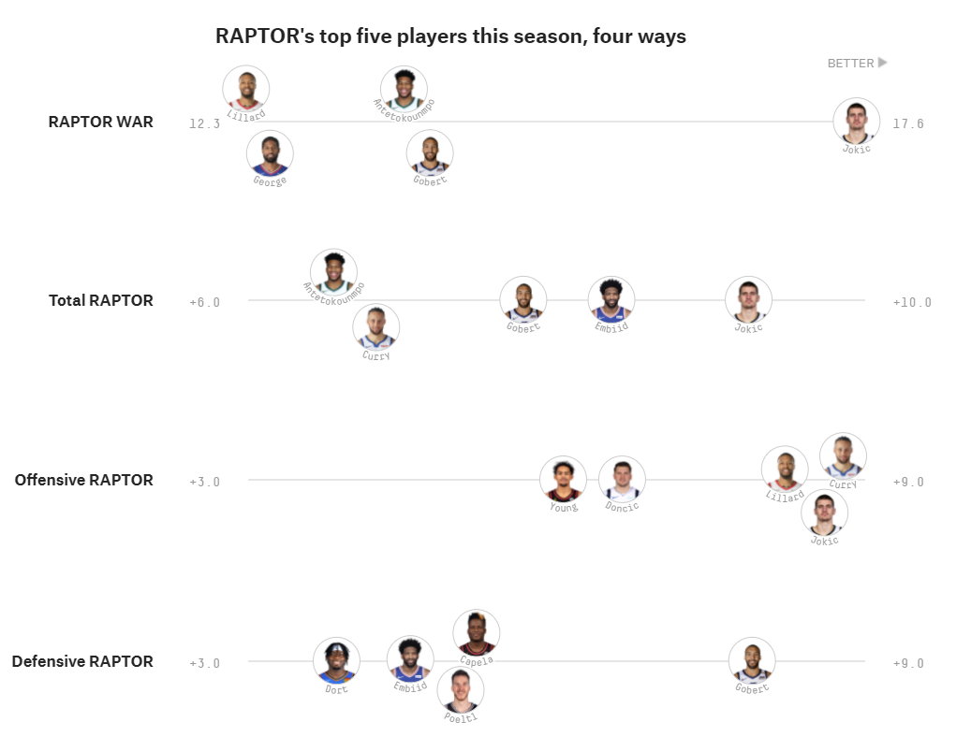
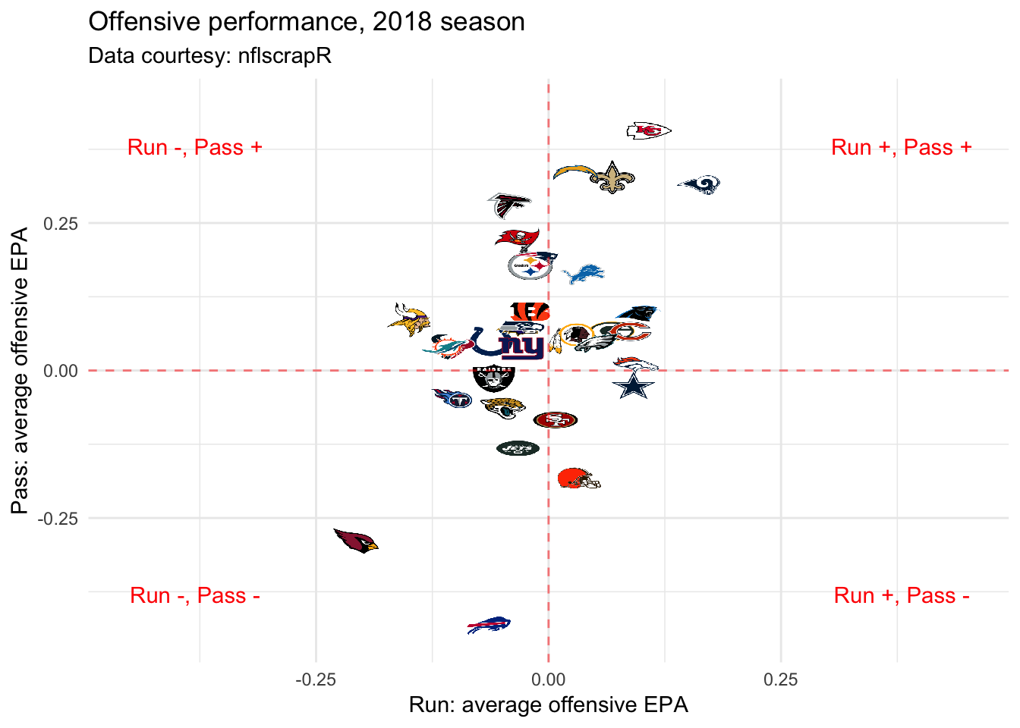
Sports Analytics Applications
Gambling and bar fights
Source: https://projects.fivethirtyeight.com/nba-player-ratings/; https://projects.fivethirtyeight.com/2021-mlb-predictions/ , https://statsbylopez.netlify.app/post/r-for-nfl-analysis/

Slide 17
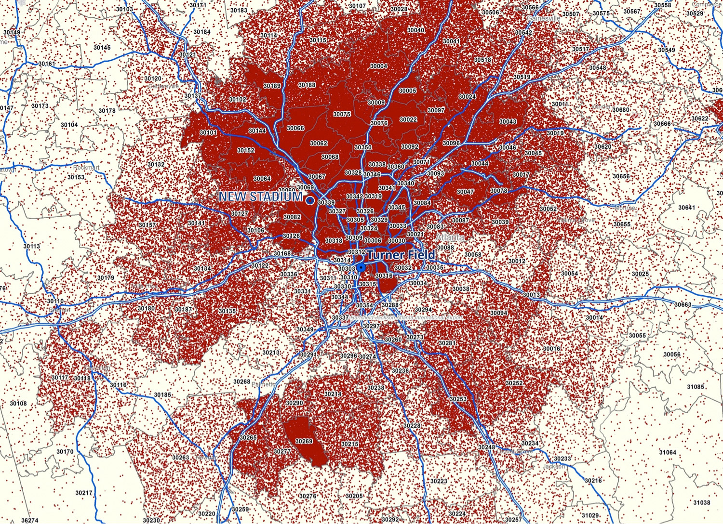
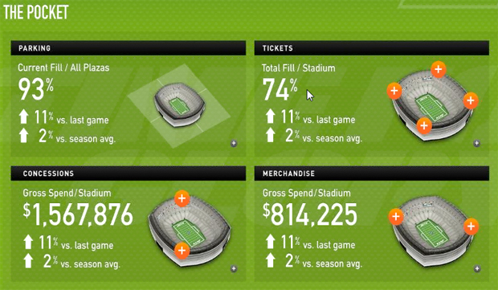
Sports Analytics Applications
Sports Business
Source: https://www.fastcompany.com/1686697/ny-jets-command-center-offers-real-time-analytics-sales-stats-freaks; https://ftw.usatoday.com/2013/11/why-the-braves-want-to-move-in-one-ticket-sales-map

Slide 18
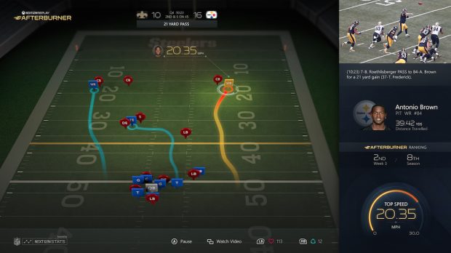
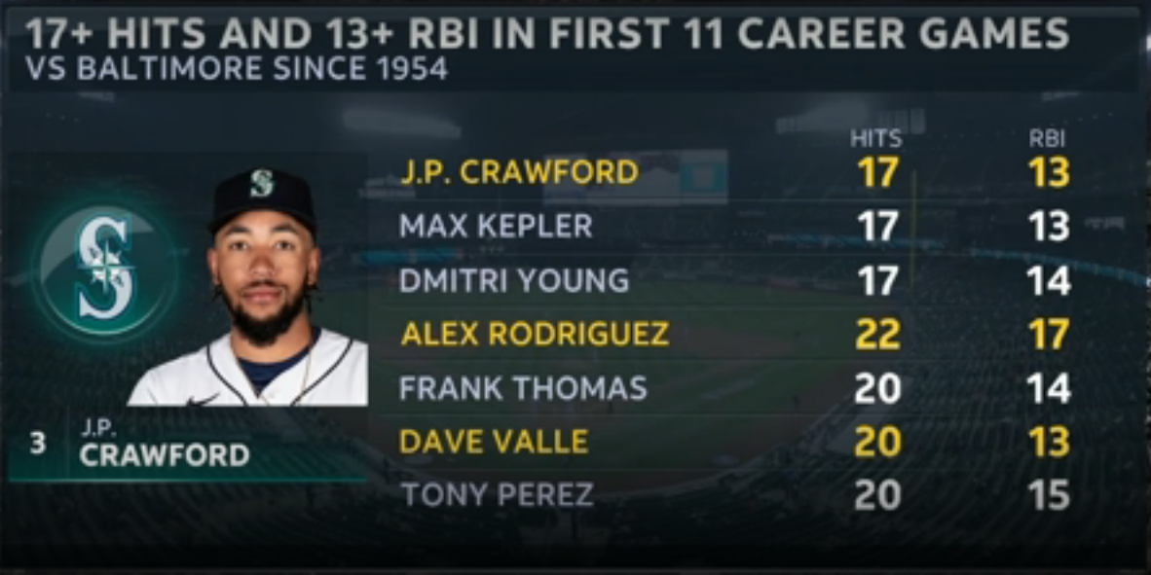
Sports Analytics Applications
Media and broadcasting, narratives
Source: https://www.reddit.com/r/baseball/comments/n4fake/root_sports_with_the_weirdly_specific_stat/, https://www.geekwire.com/2015/microsoft-will-show-next-gen-stats-on-nfl-app-thanks-to-rfid-chips-worn-by-players/

Slide 19
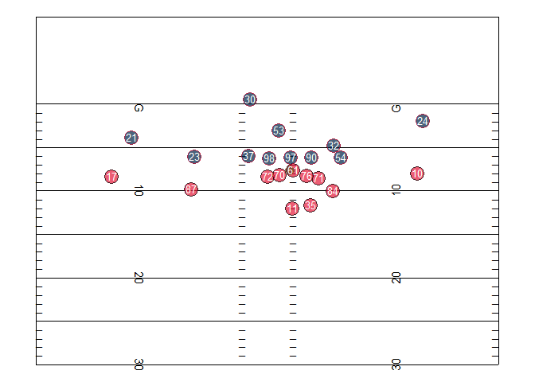
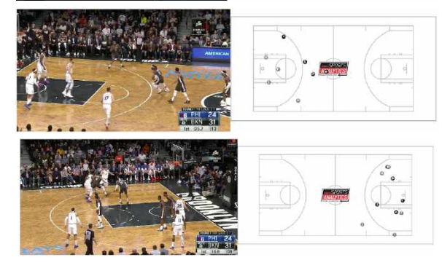
Sports Analytics Applications
Next frontier: Player tracking data
Source: https://statsbylopez.netlify.app/post/r-for-nfl-analysis/, https://www.sloansportsconference.com/research-papers/extracting-player-tracking-data-from-video-using-non-stationary-cameras-and-a-combination-of-computer-vision-techniques

Slide 20
Sports Analytics History

Slide 21
First Use of “Statistics” in Sports?
Who can push us back the farthest?
STOP!
DON’T LOOK AT FUTURE SLIDES YET.

Slide 22
First Use of “Statistics” in Sports?
Haven’t they always been there, in a sense?
Doesn’t everyone – including coaches and scouts – use them?
Jocks vs. nerds?
Culture war vs. actual disagreement on using numbers in sports
Matter of degree (literally and figuratively)
Outsiders vs. insiders

Slide 23
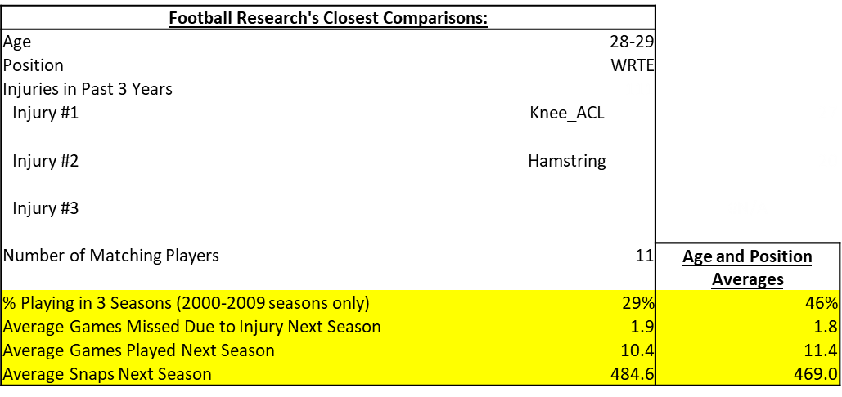
Analytics Culture War
It’s not (just) dumb nerds resisting jocks who “know how to do their job better”
“Nerd” = “Outsider”
Have to recognize we’re coming in to their house. Be humble, “there to help”
Try and integrate ourselves in existing culture/space while pressing for change. Tough balance!

Slide 24
Modern History of Statistics in Sports
DISCLAIMER: In no way comprehensive. Weighted towards sports I know more about (football, baseball)
Here’s a baseball history

Slide 25
Modern History of Statistics in Sports
Early Modern Era: 1970-2000ish
Statisticians, academics, and other “outsiders” argue they can improve sports with numbers

Slide 26
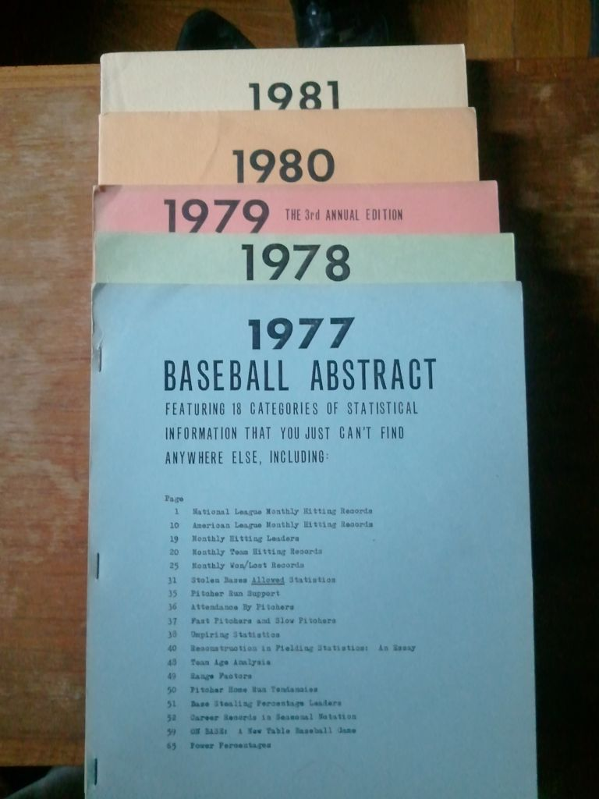
Modern History of Statistics in Sports
Early Modern Era: 1970-2000ish
“Operations research in football” – Carter & Machol, 1971
“On the optimal time to pull the goalie” – Morrison, 1976
Bill James Baseball Abstract – 1977
Rotisserie Leagues/fantasy baseball (by mail)
Source: https://homemlb.wordpress.com/2014/02/05/1977-new-candidates/

Slide 27
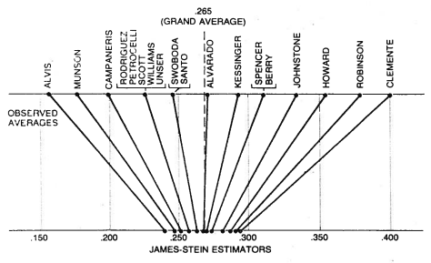
Modern History of Statistics in Sports
Early Modern Era: 1970-2000ish
“Stein’s Paradox in Statistics” – Efron and Morris, 1977
Hidden Game of Football – Carroll, Thorn, and Palmer, 1988
Source: https://statweb.stanford.edu/~ckirby/brad/other/Article1977.pdf

Slide 28
Modern History of Statistics in Sports
Turn of the Millennium: 2000-2015ish
Greater data availability
Internet, bloggers, public analyses → team hires
Public profile grows
Moneyball, 2003
Source:

Slide 29



Modern History of Statistics in Sports
Turn of the Millennium: 2000-2015ish
BaseballProspectus.com (1997)
Baseball-Reference.com (2000)
Pro-Football-Reference.com (2003)
FootballOutsiders.com (Aaron Schatz; 2003)
Basketball on Paper (Dean Oliver; 2004)
Sports Reference (Sean Forman; 2004; now includes basketball, hockey, soccer, college basketball/football)
Fangraphs (2005)
Advanced Football Analytics (Brian Burke; 2006-16)
Source: https://homemlb.wordpress.com/2014/02/05/1977-new-candidates/

Slide 30
Modern History of Statistics in Sports
Firehose/Player Tracking Era: 2015ish-Now
Proliferation of individual blogs, websites, independent sports analyses, sports analytics clubs
Massive increases in data for public but especially for private team work
Tracking data firehose; data engineers, architects critical
Team hiring accelerates (non-baseball 0 → some, baseball some → whole departments)
Source:

Slide 31
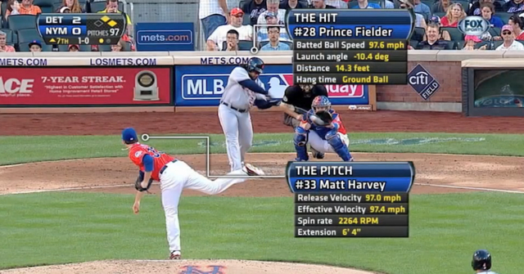
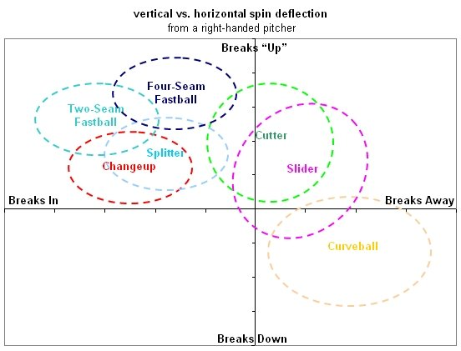
Modern History of Statistics in Sports
Firehose/Player Tracking Era: 2015ish-Now
Baseball: Statcast/Hawkeye
Previously Trackman, PitchF/X
Source: https://www.etcentric.org/mlbs-statcast-tech-could-revolutionize-the-game-of-baseball/; https://library.fangraphs.com/pitch-type-abbreviations-classifications/

Slide 32
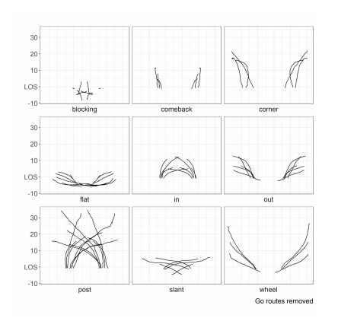
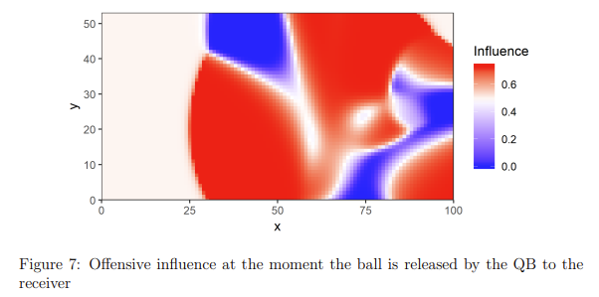
Modern History of Statistics in Sports
Firehose/Player Tracking Era: 2015ish-Now
Football: Player Tracking data
Source: https://statsbylopez.netlify.app/post/r-for-nfl-analysis; https://operations.nfl.com/media/3670/big-data-bowl-sfu.pdf

Slide 33
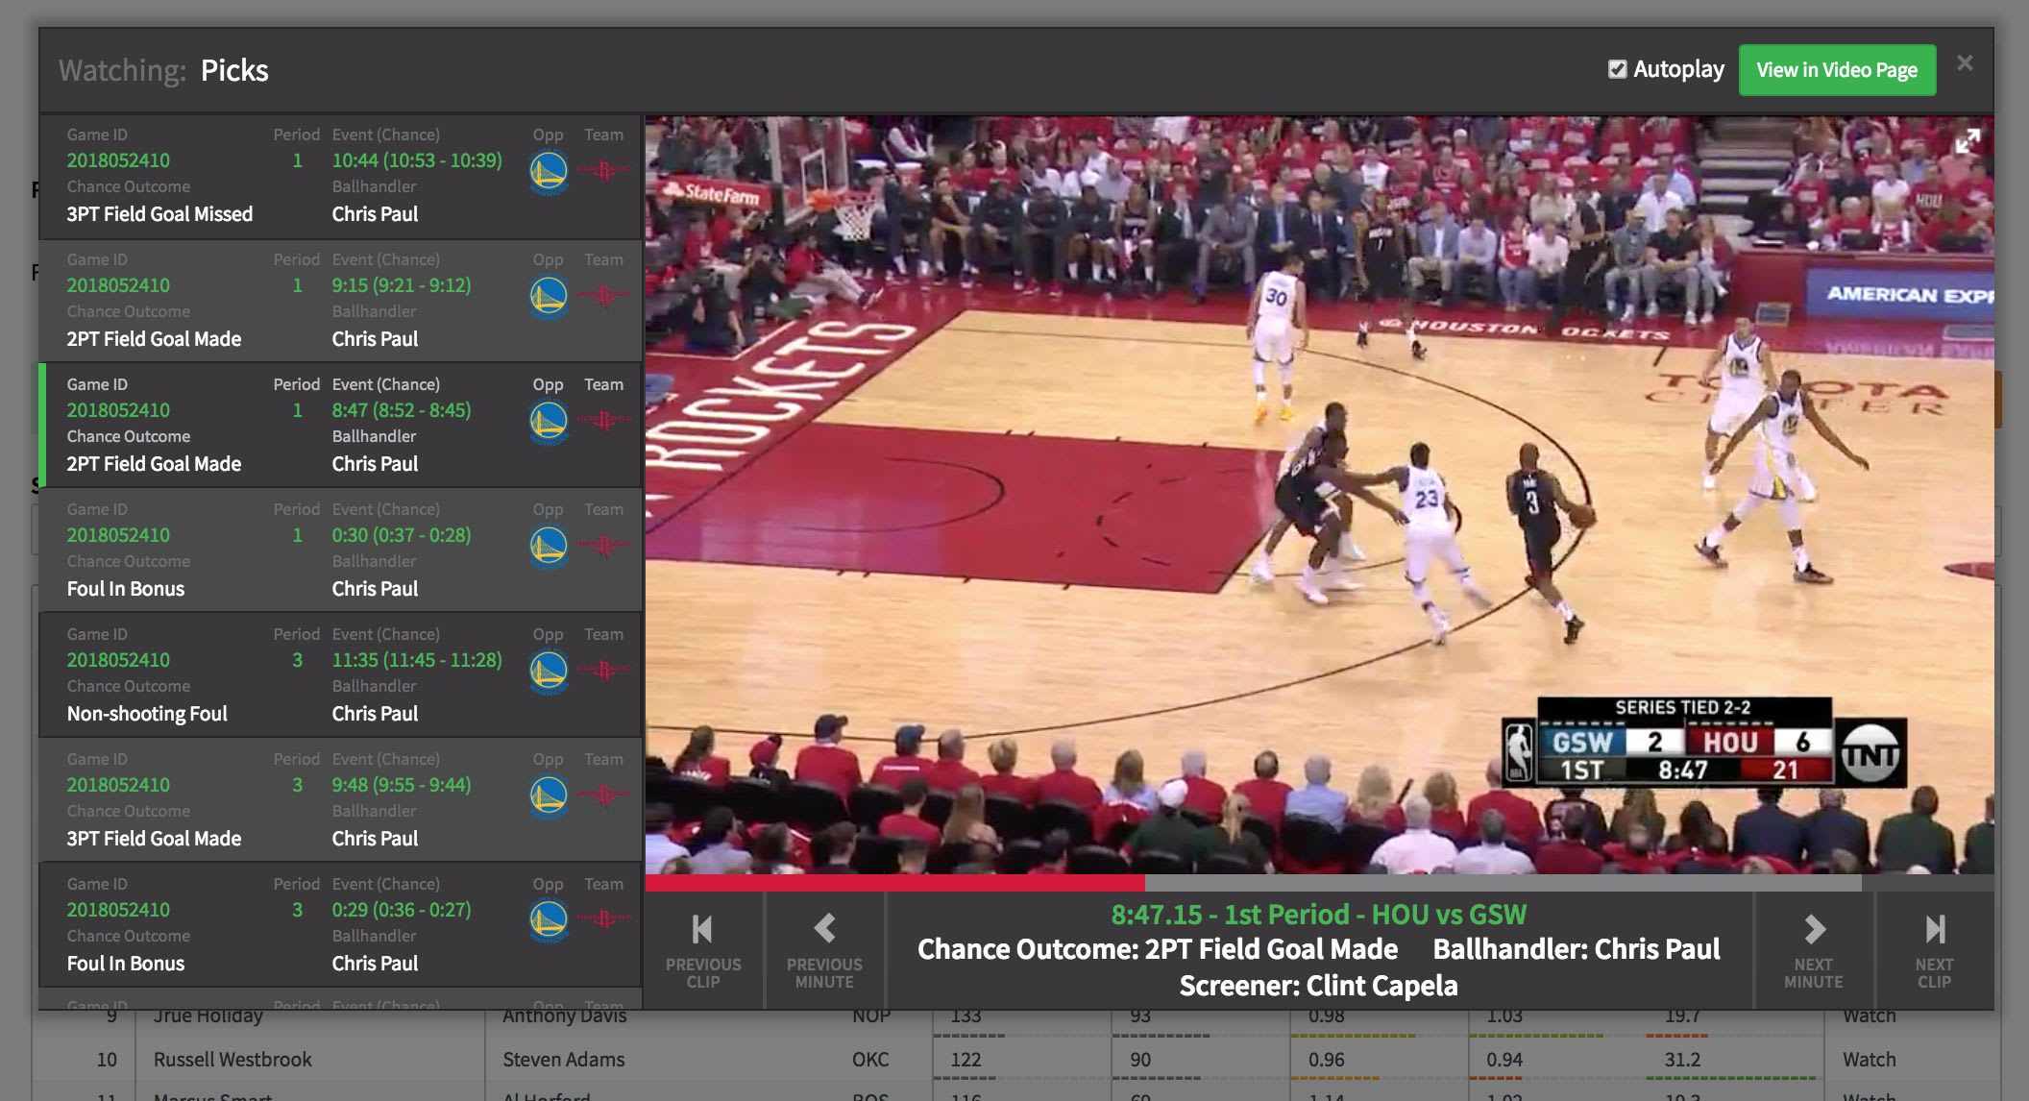
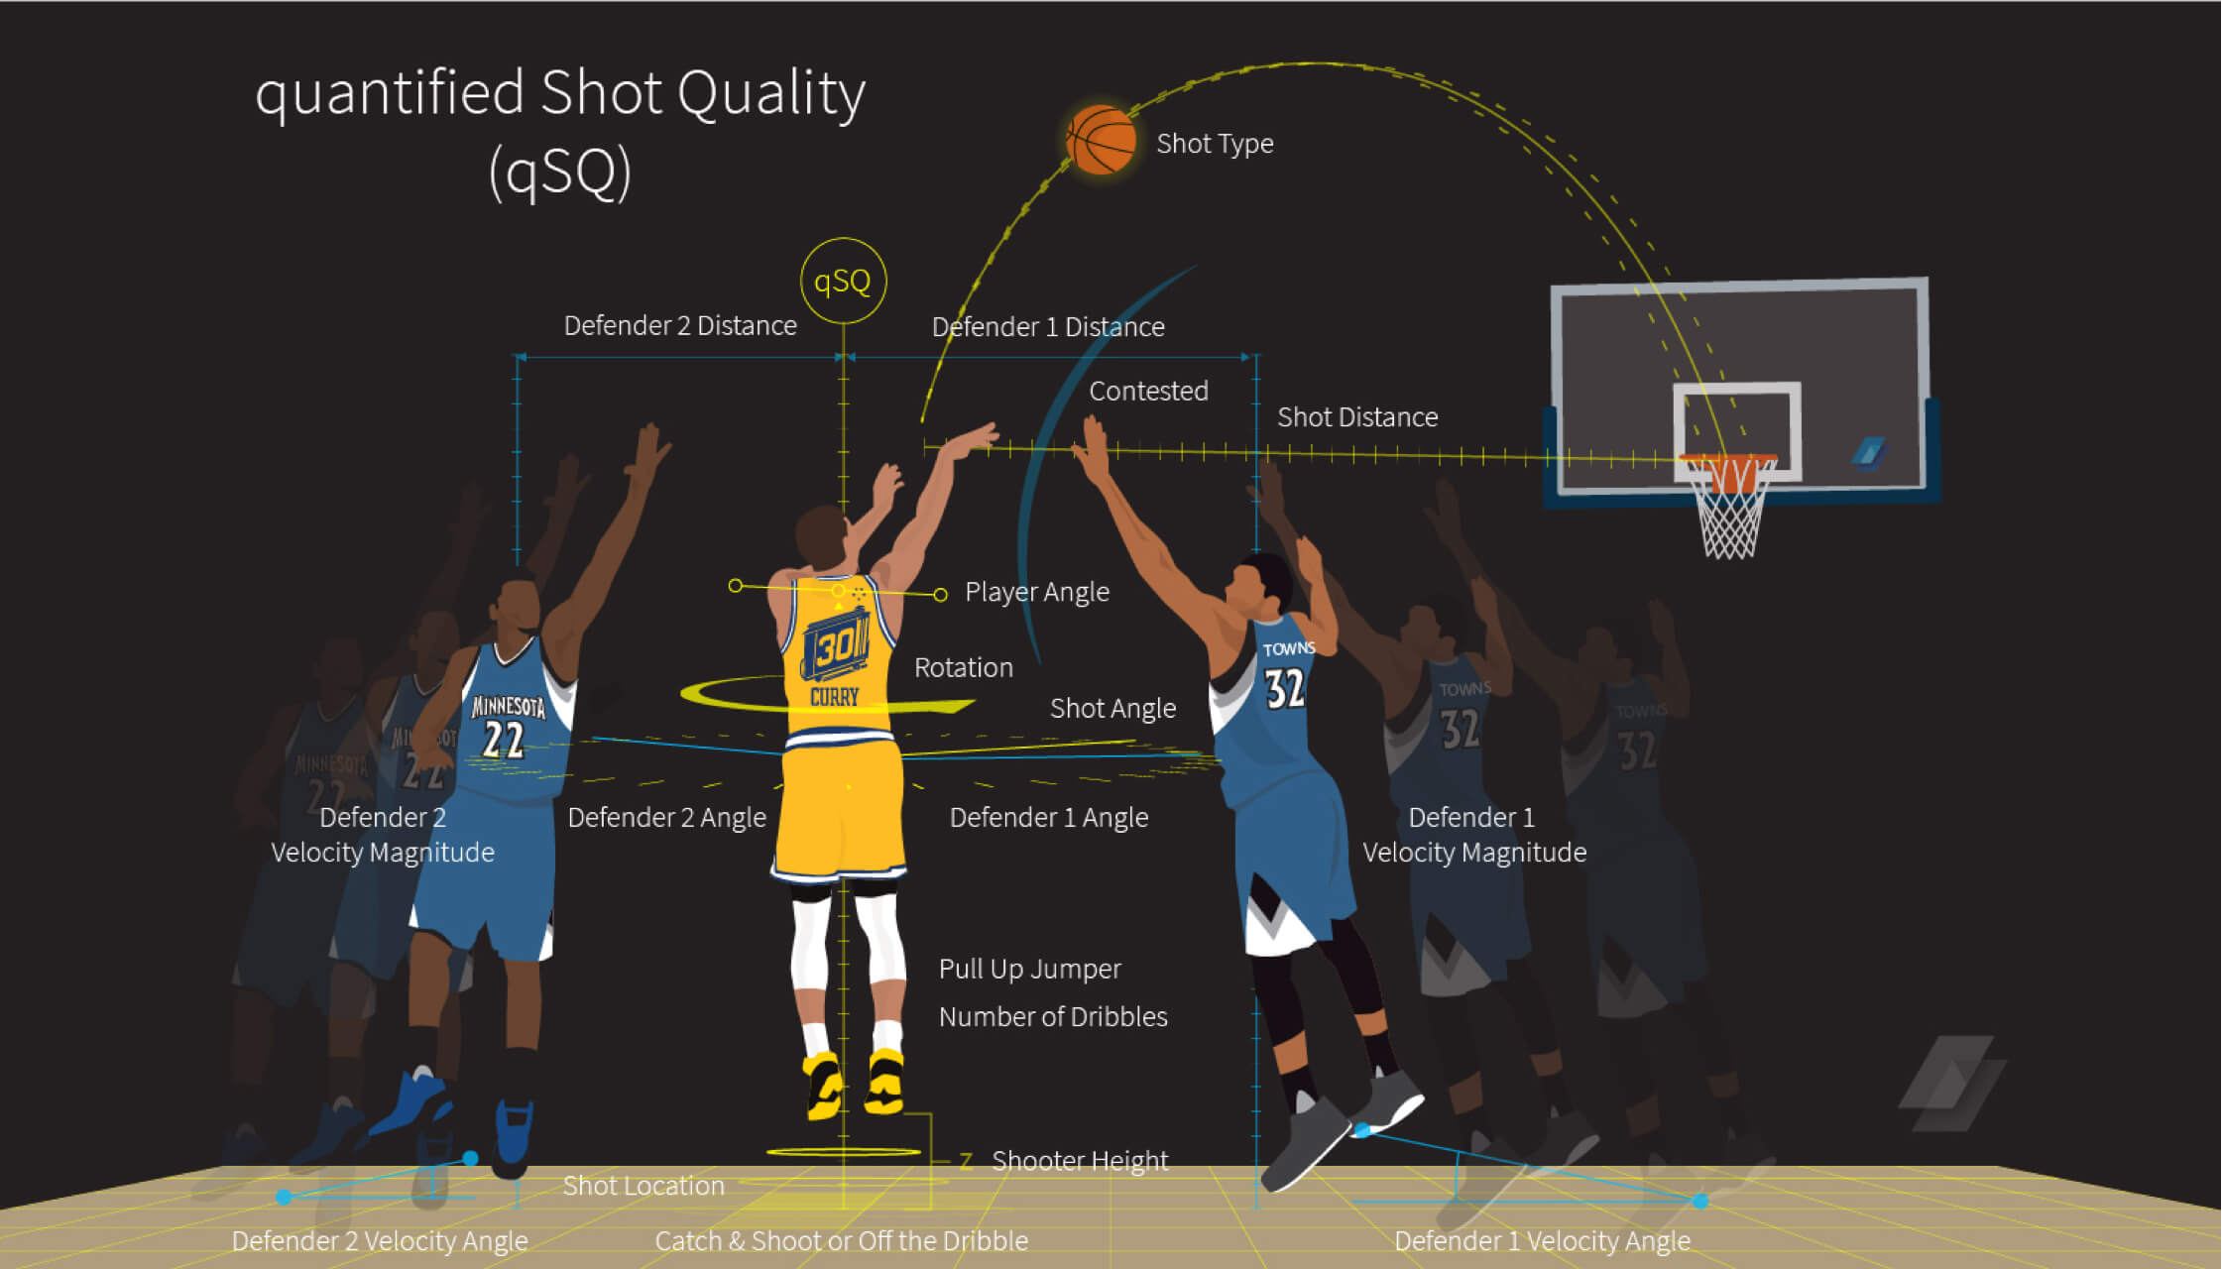
Modern History of Statistics in Sports
Firehose/Player Tracking Era: 2015ish-Now
Basketball: Second Spectrum (prev. SportVu)
Source: https://fansided.com/2018/06/28/second-spectrum-redesigning-nba/; https://www.secondspectrum.com/press/2016-05-13.html

Slide 34
Aside: Fantasy Draft
Split into your teams. What is your draft strategy? Explain to your teammates, then we’ll discuss as a class.
Do your VORPal blades go snicker snack?

Slide 35
Next Class
For next class:
Any pre-FF draft research you’d like
Install R and Rstudio (complete “Tutorial 0”) if you haven’t already
OPTIONAL: play around with the sports databases in Tutorial 1. Come up with a question you’d like to answer using them.

Slide 36

Thanks!
Questions? zbinney@emory.edu, @binney_z on Twitter

